Slide 1
A project 2D matrix and raylib
1410 | Drishya Karki
Title defense of Project-I –DWIT 035– Class of 2028

Slide 2
Outline
Introduction
Problem Statement
Objective
Scope
Literature Review/Background Study
Methodology
Tools and Technology
Expected Outcome
Reference

Slide 3
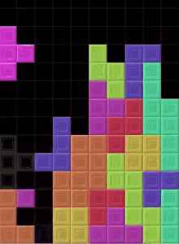
Introduction
Tetris is a classic tile-matching puzzle game
Players arrange falling geometric blocks (tetrominoes)
Objective is to clear horizontal lines without overflowing the board

Slide 4
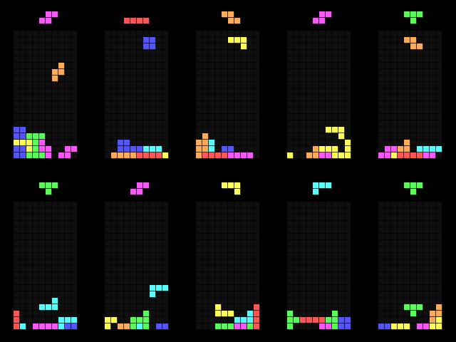
Why Tetris?
Simple concept but complex internal logic
Ideal for understanding real-time game systems
Widely used as a learning benchmark in game development

Slide 5
Problem Statement
Many beginner game projects lack proper structure and scalability
Basic games often do not demonstrate real-time logic and state management
This project aims to design a structured and feature-rich Tetris game Focus is on logic, performance, and clean object-oriented design

Slide 6
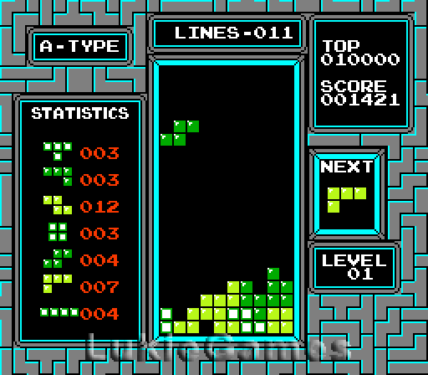
Objective
To develop a fully playable Tetris game
To apply Object-Oriented Programming principles in C++
To implement real-time game mechanics using a game loop
To understand collision detection and matrix-based rotation
To build a scalable project suitable for future enhancements

Slide 7
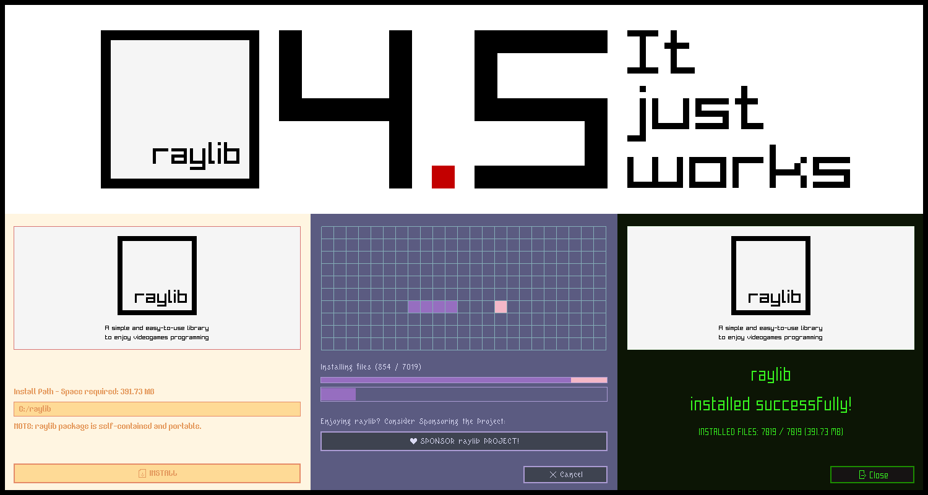
Scope
Development of a single-player Hard Mode Tetris game
Implementation of core and advanced Tetris mechanics
Use of C++ and Raylib for real-time graphics and input handling
Focus on game logic, performance, and object-oriented design
Target platform: Desktop (Windows)
Designed as an educational and scalable project

Slide 8
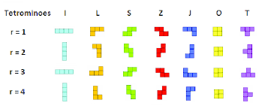
Literature Review/Background Study
Studied the original Tetris game mechanics and gameplay rules
Reviewed classic implementations of grid-based puzzle games
Analyzed common data structures used in Tetris:
  2D arrays for board representation Matrices for tetromino rotation
  Studied object-oriented design patterns for game development
Reviewed Raylib documentation for:
  Rendering Input handling Timing
  Studied collision detection techniques in 2D games

Slide 9
Methodology
Requirement Identification
  Identify core and advanced features of Tetris
  Define game rules and constraints
  Select appropriate tools and technologies
Feasibility Study
  Technical
  Operational
  Economic
High-Level Design of System (system flow chart/ methodology of the proposed system)

Slide 10
Methodology
Feasibility Study
  Technical
    The project is developed using C++, which is well-supported and efficient for real-time applications
    Raylib is used for graphics, input handling, and timing control
    The system does not require high-end hardware or external game engines
  Operational
    The game operates using simple keyboard controls
    The user interface is minimal and intuitive
    No special installation or configuration is required for the end user
    The system is easy to run, play, and maintain
  Economic
    No licensing or subscription costs involved
    Development requires only a standard personal computer
    No additional hardware investment is needed

Slide 11

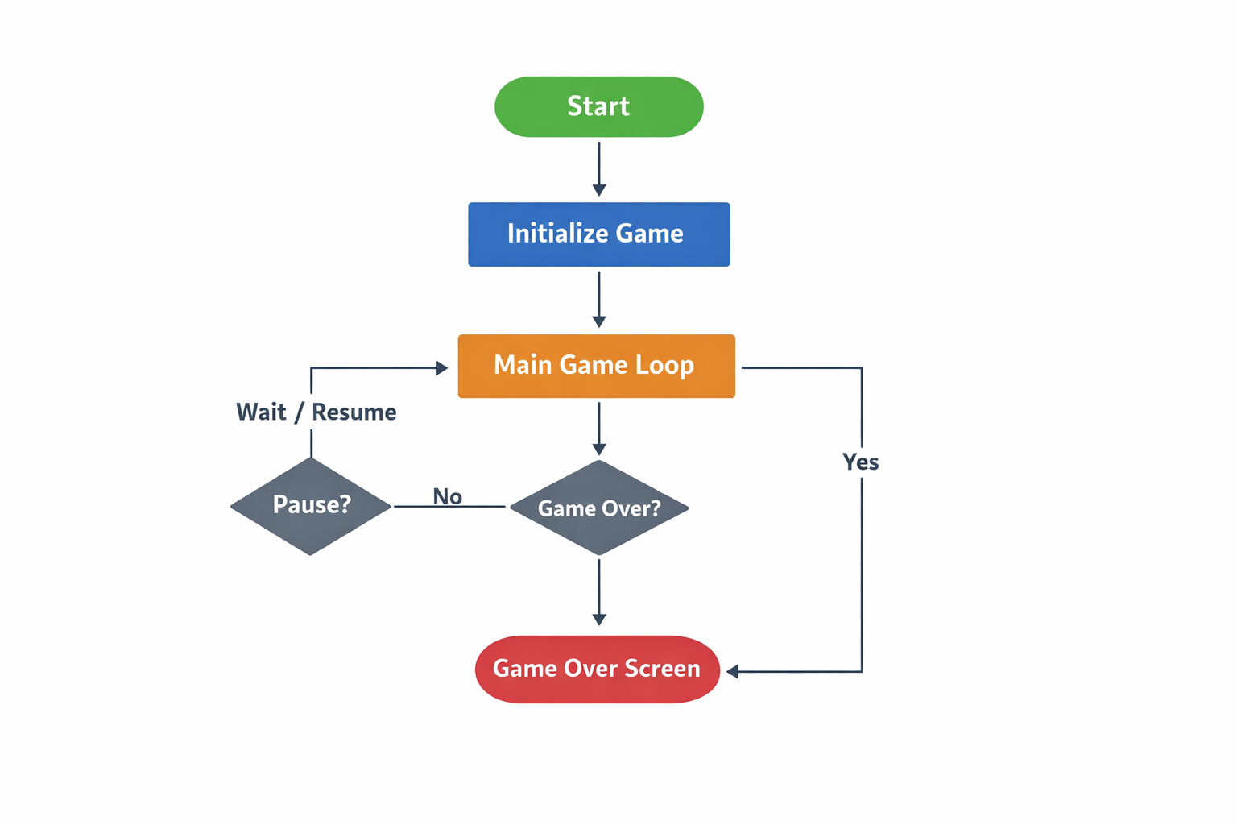
High-Level Design of System
  System Flow Description The system follows a real-time game loop architecture.
  Step-by-Step Flow:
  Start Game
    Initialize window, graphics, and game variables
    Load assets (fonts, colors, sounds)
  Main Menu State
    Display start options
    Wait for user input
  Game Loop
    Begins Runs continuously until the game ends
  Input Handling
    Capture keyboard inputs
    Validate movement, rotation, and hold actions
  Game Logic Update
    Apply gravity based on time
    Check collisions
    Lock tetromino if collision occurs
    Clear completed lines
    Update score and level
  Hard Mode Mechanics
    Apply wall kick logic during rotation
    Display ghost piece
    Handle hold and next-piece queue
  Rendering
    Draw game board
    Draw current tetromino
    Draw UI elements (score, level)
  State Check
    Check for pause or game over condition
    Switch states accordingly
  End Game
    Display game over screen
    Option to restart or exit

Slide 12
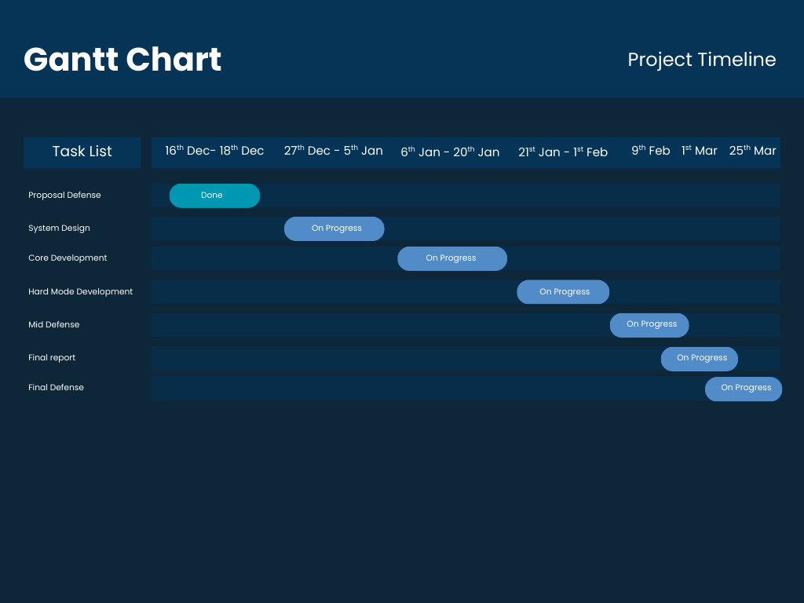
Gantt Chart

Slide 13
Expected Outcome
A fully playable Tetris game
Clean and modular C++ codebase
Proper use of OOP principles
Smooth and frame-rate independent gameplay
Correct implementation of collision detection and rotation logic
Clear demonstration of:
  Game loop architecture
  State management
  Matrix-based transformations

Slide 14
References
Pajitnov, A.
  Tetris Game Design and Mechanics
  Original concept and rules of the Tetris game.
Raylib Documentation Raylib
    A Simple and Easy-to-Use Library to Learn Game Programming https://www.raylib.com
GameBoy
  Tetris Overview of Tetris gameplay, rules, and mechanics
Game Loop
  Game Loop Explanation of real-time game loop architecture
  https://gameprogrammingpatterns.com/game-loop.html
SFML & Raylib Community Examples
Used for understanding grid-based game implementation and rendering techniques.

Slide 15
Thank You!!!!!

